Slide 1

From “Hearing Impairment” to “Deaf Gain”
Dr. H-Dirksen L. Bauman
Professor and Chair, ASL and Deaf Studies
Universal Learning Design Conference, Masaryk University
Czech Republic, Feb. 14, 2013

Slide 2
Thank you
Masaryk University
Petr Penaz and Conference Organizers
Interpreting Team
Colleagues:
  Joseph Murray
  Melissa Malzkuhn

Slide 3
It’s all about hospitality

Slide 4
Universal Design in Learning
Deaf Studies

Slide 5
Universal Design in Learning
Deaf Studies
Frame Analysis

Slide 6
Universal Design in Learning
Deaf Studies
?
Frame Analysis

Slide 7
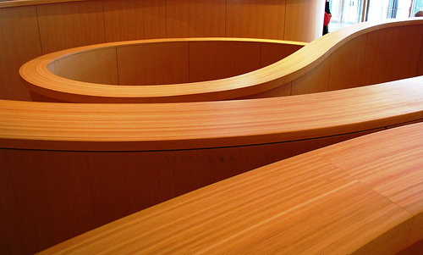
Universal Design in Learning
Deaf Studies
?
Frame Analysis

Slide 9
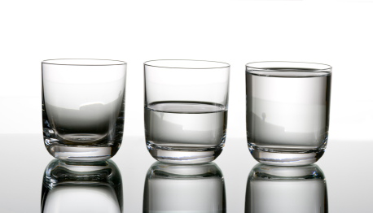
The Difference a Frame Makes

Slide 10
Which is full?
Goffman, Erving. Frame Analysis

Slide 11
Which is full?
water
water
water
water
Goffman, Erving. Frame Analysis

Slide 12
Which is full?
air
air
air
air
Goffman, Frame Analysis

Slide 13
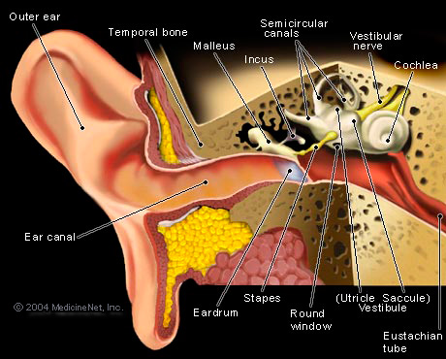
“Hearing Loss”
=
“Hearing Impairment”

Slide 14
Hearing Loss
deviant
disability
pathology
incapable
broken
loss
isolated
Hearing Impairment

Slide 15
Normalcy
Hearing loss
=
Hearing Loss
Normalcy

Slide 16
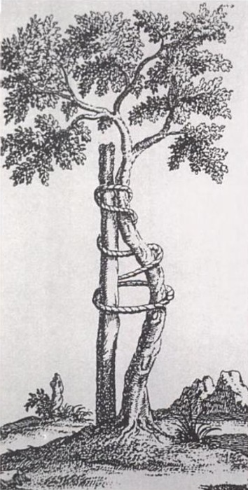
Normalcy: a 19th Century Invention

Slide 17
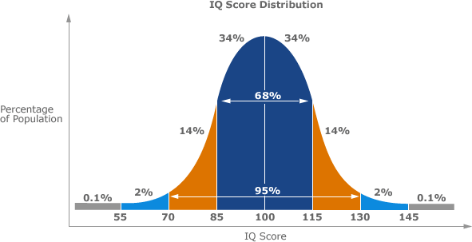
Normalcy
Normalcy
Notes:
Add sonogram
Weight

Slide 18
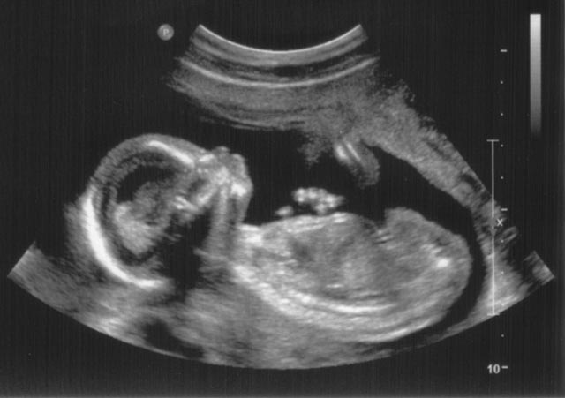
Normalcy
Normalcy
Notes:
Add: how important our
sonogram
Weight

Slide 19
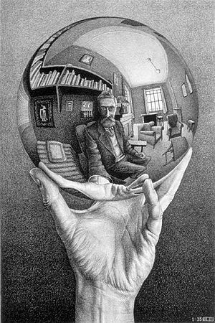
Time to Reflect

Slide 20
Is normalcy the only frame?

Slide 21
Let’s go back to the beginning….

Slide 22


Slide 23

Biological diversity
diversidade biocultural
Biocultural Diversity
Notes:
Health of an ecosystem
As opposed to Mono culture….

Slide 24

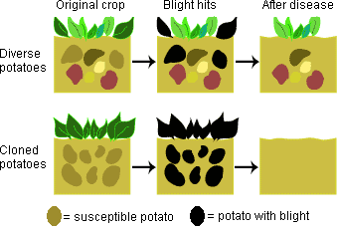
Less biodiversity = monoculture

Slide 25
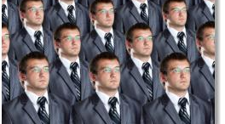
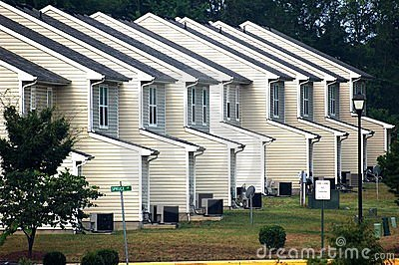
Less cultural diversity = monoculture

Slide 26
Biocultural diversity
Deaf
?
Deaf
Biocultural Diversity

Slide 27
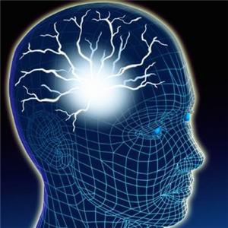


Deaf Gain
Add hand and eye here
Deaf Gain
Notes:
Transition

Slide 28
Deaf Gain: [def geyn] The cognitive, creative and cultural benefits and contributions that result from d/Deaf ways of being in the world.
Deaf Gain
Deaf Gain

Slide 29
Deaf-Gain
Cognitive Diversity
Creative Diversity
Cultural Diversity
Bauman and Murray, 2010, 2009

Slide 30
Deaf-Gain:
Cognitive Diversity

Slide 31
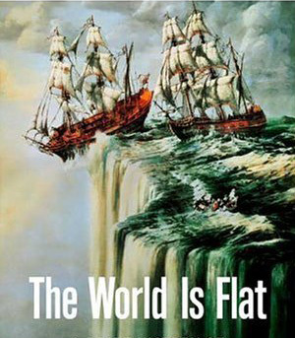
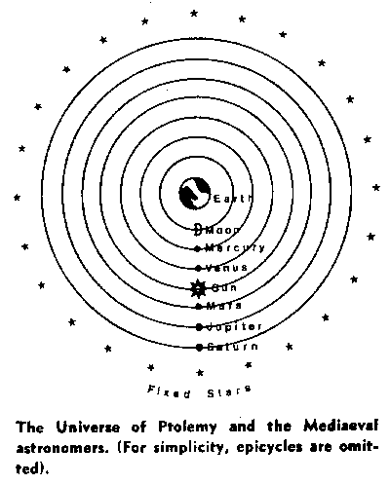
Deaf Gain: Cognitive Diversity
Historic Human Misunderstandings

Slide 32
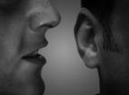
Historic Human Misunderstandings
Language = Speech

Slide 33
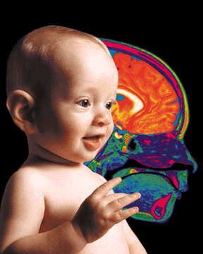
Now we know:
To Sign Is Human!

Slide 34
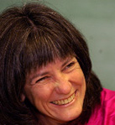
Deaf Gain: Cognitive Diversity
Manual Intelligence
“Gesture makes learning last”
Cook, Mitchell and Goldin-Meadow, 2008

Slide 35
7+3+4 = __ +4
Speech and gesture
Speech only
Gesture only
Cook, Mitchell and Goldin-Meadow, 2008

Slide 36
7+3+4 = __ +4
Speech and Gesture = .92
Speech only= .33
Gesture only = .80
Cook, Mitchell and Goldin-Meadow, 2008

Slide 37

The Hand
“Hands are the instrument of creation and, above all, they are the organs of knowledge”
Henri Focillon, “Eloge de la main” Presses Universitaires de France, (1943), 1996

Slide 38
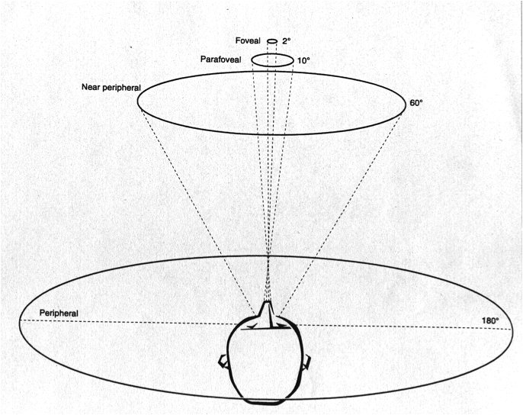
Deaf Gain: Cognitive Diversity
Visual-Spatial Gains
Increased peripheral recognition skills
(Dye, et al 2009; Bavelier et al., 2000)

Slide 39
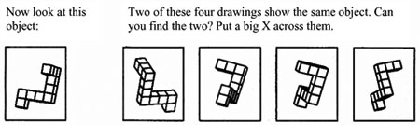
Deaf Gain: Cognitive Diversity
Visual-Spatial Gains
mental rotation skills
(Emmorey, Klima, & Hickok et al., 1998)

Slide 40
Deaf Gain: Cognitive Diversity
Visual-Spatial Gains
mental rotation skills
(Emmorey, Klima, & Hickok et al., 1998)

Slide 41
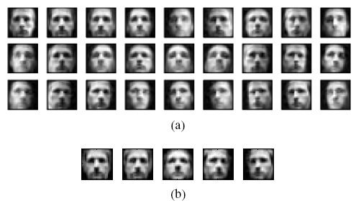
Deaf Gain: Cognitive Diversity
Visual-Spatial Gains
Enhanced facial recognition
Arnold, P., & Murray, C. (1998).

Slide 42
Deaf Gain: Cognitive Diversity
Visual-Manual Education
=
+
Notes:
Dirksen

Slide 43
Deaf Gain
Creative Diversity

Slide 44
Deaf Gain: Creative Diversity
Sign Language Literature
Visual Art
Filmmaking
Drama
Performance

Slide 45
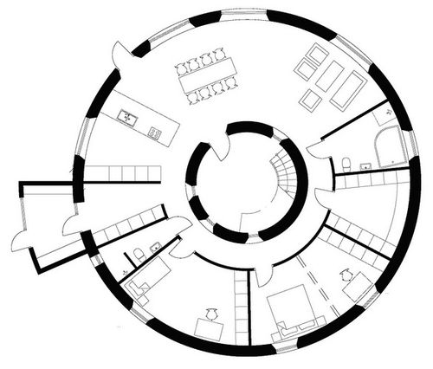
Deaf-Gain: Creative Diversity
  Architecture Deaf Space

Slide 46
Deaf Gain:
Cultural Diversity

Slide 47
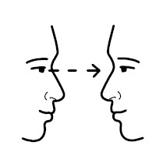
Deaf-Gain: Cultural Diversity visual intersubjectivity
Bauman and Murray, 2010, 2009
Sirvage, 2012

Slide 48
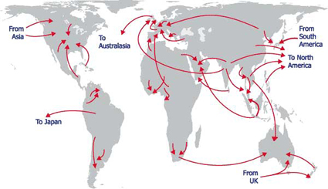
Deaf-Gain: Cultural Diversity transnational identities
Bauman and Murray, 2010, 2009

Slide 49
Deaf GAIN Implications:
Universal Design for Learning

Slide 50
Universal Design in Learning
Deaf Studies
?
Frame Analysis

Slide 51
UDL Frame?
Access for persons with disabilities.

Slide 52
Normalcy
UDL
Access
UDL
Normalcy

Slide 53
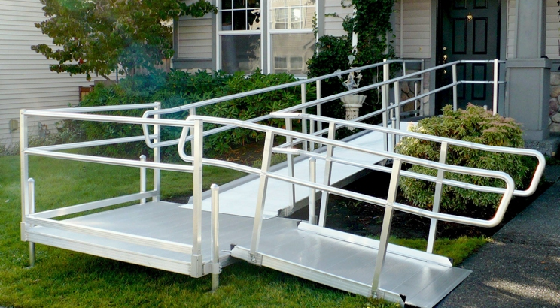
In this frame,
UDL is a humane add-on.

Slide 54
Again, we ask,
Is normalcy the only frame?

Slide 55
Let’s go back to the beginning….

Slide 56
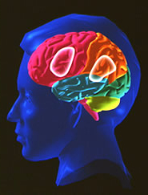

Slide 57
Cognitive Diversity
neuroplasticity
Neurodiversity
UDL
Multiple Intelligences

Slide 58
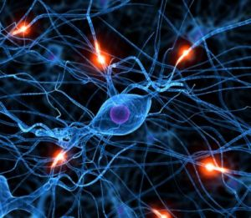
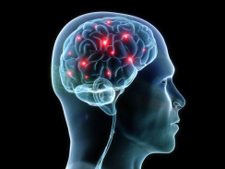
Cognitive Diversity
UDL suggests a more radical transformation of education
neuroplasticity
Neurodiversity
UDL
Multiple Intelligences

Slide 59
Cognitive Diversity
In this frame, UDL looks more like this:
neuroplasticity
Neurodiversity
UDL
Multiple Intelligences

Slide 61
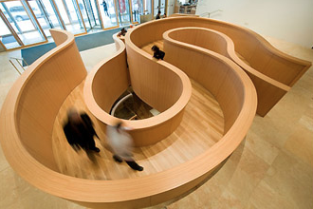
Art Gallery of Ontario, new addition:
Frank Gehry, Toronto, Canada

Slide 62
Deaf Gain = UDL Gain
Reframing “Disability”
Deaf Space Learning Design:
  Deaf Space Classrooms
  Visual / Tactile Community
  Visual/Spatial Language

Slide 63
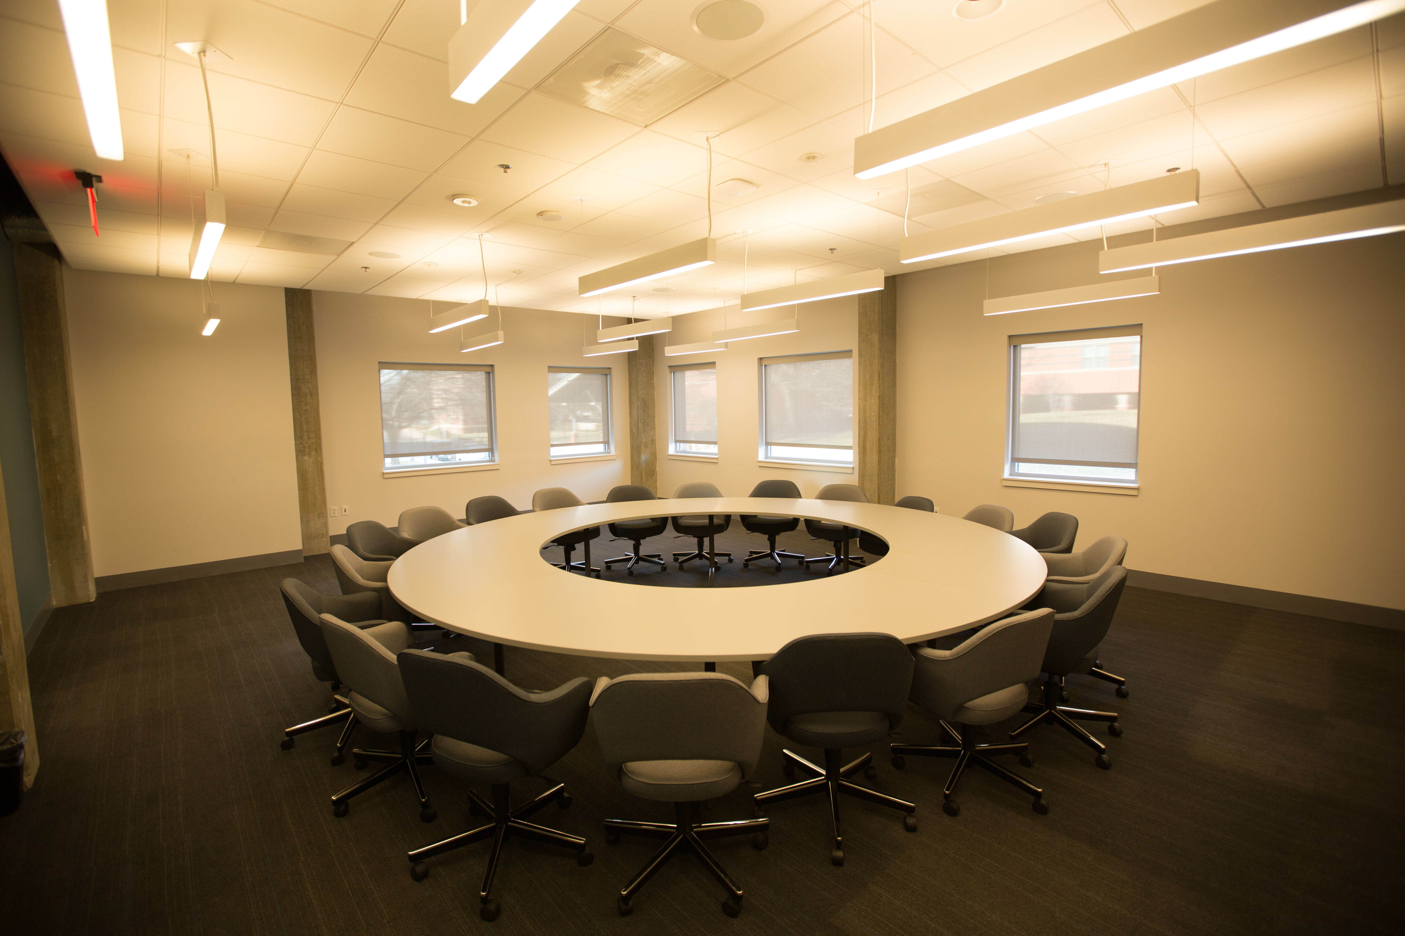

Slide 64
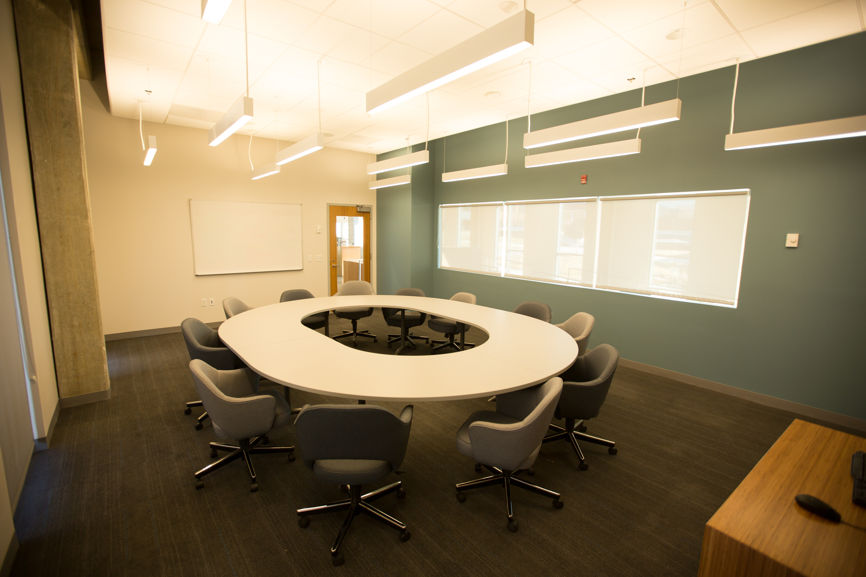

Slide 65
Classroom as a
Visual/Tactile Community
Ritual of establishing visual readiness

Slide 66
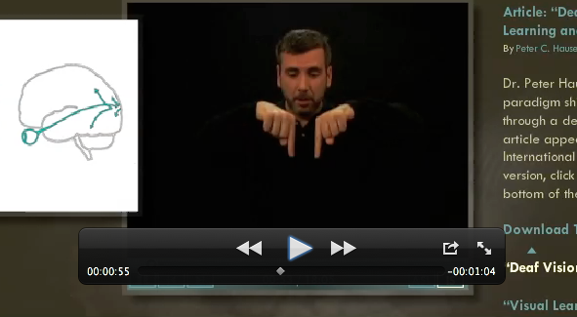
Visual/Spatial Language

Slide 67
Deaf Gain UDL Gain
Future Implications….

Slide 68
Implications for UDL Gain
Universal Design for Learning Gain takes the lead in Teacher Education.
  Making UDL central to faculty development and teacher education
  Teachers become better after a UDL Makeover

Slide 69
Implications for UDL Gain
2) UDL-Gain rethinks the notion of “special needs” students. Isn’t everyone special?
Curb cuts for whom?
Interpreters for whom?
Blind friendly tiles for whom?

Slide 70
Implications for UDL Gain
3) UDL-Gain redefines the “new normal” as the astounding diversity of ways of learning and knowing.

Slide 71
Time to Reflect

Slide 72
It’s all about
hospitality
Notes:
Establishing connections
Fostering engagement
Take advantage of visual/manual intelligence
Classroom hospitality.

Slide 73
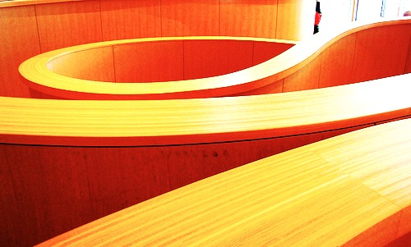
Armstrong, Thomas. 1993. Multiple Intelligences in the Classroom. Alexandria, VA: Association for Supervision and Curriculum Development.
Armstrong, Thomas. “Special Education and the Concept of Neurodiversity.”
http://www.newhorizons.org/spneeds/inclusion/information/armstrong.htm (Retrieved
October 4, 2009).
Bauman, H-Dirksen L. 2006. Getting out of line: Toward a visual and cinematic poetics of ASL. In Signing the body poetic: Essays on American Sign Language literature, ed Bauman, H-D., Nelson, J., & Rose, H, 95-117. Berkeley: University of California Press.
Bauman, H-Dirksen L, and Joseph Murray. Deaf Studies in the 21st Century: Deaf-Gain and the Future of Human Diversity. In Oxford Handbook on Deaf Studies, Language and Education, eds. Marc Marschark and Patricia Spencer. Oxford: Oxford UP, 2010.
Bavelier, D., Tomann, A., Hutton, C., Mitchell, T. V., Corina, D. P., Liu, G., & Neville, H. J. 2000. Visual attention to the periphery is enhanced in congenitally deaf individuals. Journal of Neuroscience, 20, 1-6.
Belanger, N. N., Slattery, T. J., Mayberry, R. I., & Rayner, K. (in press). Skilled deaf readers have an enhanced perceptual span in reading. Psychological Science.

Slide 74
Bellugi, U.; O'Grady, L.; Lillio-Martin, D.; O'Grady Hynes, M.; Van Hoek, K.; and Corina, D. 1989. Enhancement of Spatial Cognition in Deaf Children. In Gesture to Language in Hearing Children, ed. V. Volterra and C. Erting. New York: Springer Verlag.
Bettger, J. G., Emmorey, K., McCullough, S.H.& Bellugi U. 1997. Enhanced facial discrimination: Effects of experience with American Sign Language. Journal of Deaf Studies and Deaf Education, 2 223-233.
Brooks R, Meltzoff A.N. 2002. The importance of eyes: how infants interpret adult looking behavior. Development Psychology 38 (6): 958–66.
Blume, Harvey. 1998. Neurodiversity. The Atlantic. September 30.
Cook, S. W., Mitchell, Z., & Goldin-Meadow, S. 2008. Gesture makes learning last, Cognition, 106, 1047 – 1058.
Dye, M. W. G., Hauser, P. C., & Bavelier, D. (2009). Is visual attention in deaf individuals enhanced or deficient? The case of the Useful Field of View. Public Library of Science ONE, 4(5), e5640.
Emmorey, K, Klima, S. L. & Kickok, G. 1998. Mental rotation within linguistic and nonlinguistic domains in users of American Sign Language. In Cognition, 68, 2221-226.

Slide 75
Emmorey, K. & Kosslyn, S. 1996. Enhanced image generation abilities in deaf signers: A right hemisphere effect. In Brain and Cognition, 32, 28-44.
Emmorey,, K. & Kosslyn, S., & Bellugi, U. (1993) Visual Imagery and visual-spatial language: Enhanced visual imagery abilities in deaf and hearing ASL signers. In Cognition, 46, 139-181.
Furman, N., Goldberg, D., & Lusin, N. 2007. Foreign language enrollments in united states institutions of higher education, fall 2006. Modern Language Association. http://www.mla.org/2006_flenrollmentsurvey
Gardner, Howard. 1983. Frames of Mind: The Theory of Multiple Intelligences. New York: Basic Books.
Goodwyn, S.W.,Acredolo, L.P., & Brown, C. 2000. Impact of symbolic gesturing on early language development. Journal of Nonverbal Behavior. 24, 81-103.
Lakoff, George. 2004. Don't Think of an Elephant: Know Your Values and Frame the Debate--The Essential Guide for Progressives. White River Junction, VT: Chelsea Green.
Petitto, L.A., Zatorre, R., Gauna, K., Nikelski, E.J., Dostie, D., & Evans, A. 2000. Speech-like cerebral activity in profoundly deaf people while processing signed languages: Implications for the neural basis of human language. Proceedings of the National Academy of Sciences, 97(25), 13961-13966. December 5.

Slide 76
Petitto, L.A. (2009) Sign languages as human languages. Effect of Language Delay on Mental Health. Conference. Toronto, Canada. October 16.
Reid V. M., Striano T. 2005. Adult gaze influences infant attention and object processing: implications for cognitive neuroscience. European Journal of Neuroscience. 21 (6): 1763–6. March.
Schmitz, Kenneth. 1998. Towards A Contemporary Anthropology of the Person. Presented at the Institute for American Values consultation of the human person, New York, NY, 1998. http://www.americanvalues.org/html/contempanthrop.html (Retrieved October 4, 2009).
Stokoe, William. 2001. Language in Hand: Why Sign Came Before Speech. Washington, DC: Gallaudet University Press.
Veditz, George. Presidential Address Proceedings of the Ninth Convention of the National Association of the Deaf and the Third World’s Congress of the Deaf, 1910 (Los Angeles, CA: Philocophus Press, 1912, p. 30.
Visual Language and Visual Learning Science of Learning Center. http://vl2.gallaudet.edu/. (Retrieved October 4, 2009).
Wilson, Frank. 1998. The Hand: How Its Use Shapes the Brain, Language, and Human Culture. New York: Pantheon.

